Slide 1
Employee Attrition Case Study
Dan McDonough

Slide 2
Background
The case study prompt provides simulated employee profiles for ~ 1,500 employees.
During this timeframe, approximately 16% of employees have left the company.
Employee turnover produces significant burden on the company in terms of: cost of acquiring/onboarding employees, loss of institutional knowledge, and reduced capacity.
The focus of the analysis is twofold: providing an understanding of what is driving the attrition, and developing interventions that can be used to mitigate future turnover.

Slide 3
Agenda
1
Data Exploration
Data Overview & Inspection
Data Preparation, Feature Engineering, and Feature Selection
Unsupervised Learning
Attrition Modeling
Modeling Approach
Results & Summary
Feature Importance
Inference & Insights
Visualized Business Insights
Hypotheses of Causal Factors
Recommended Next Steps
A
B
C
Supplemental Information
Included for Technical Assessment
2
A
B
C
3
A
Core deliverable to case study prompt
B
C

Slide 4
Data Exploration: Data Overview
1
A
Employee profiles are robust, though timeframe and population of the data are unclear

Slide 5
Data Exploration: Data Inspection
1
A
Tables have similar records and are unique by employee; data are split into train/test files
Full Data
1470, 16%
Training Data
1102, 16%
Test Data
368, 16%

Slide 6
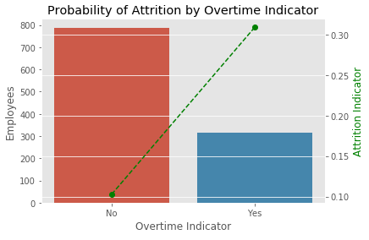
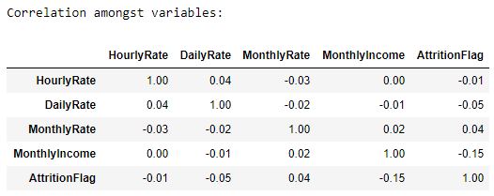
Data Exploration: Data Preparation
1
B
Data were inspected for missing values and outliers, though no such issues were present
Variable distributions were analyzed along with their relationship to the dependent variable

Slide 7
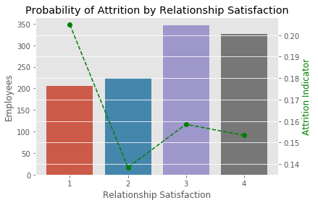
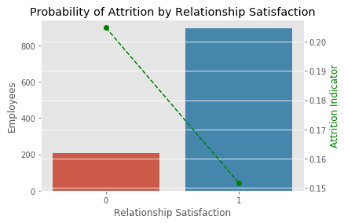
Data Preparation: Binning Variables
1
B
Some variables are binned to better establish linear relationship with dependent variable

Slide 8
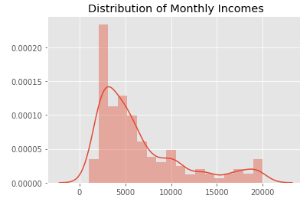
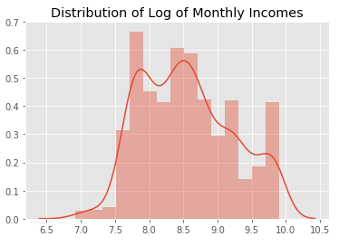
Data Preparation: Transforming Variables
1
B
Some positively-skewed variables are log transformed to better approximate normality

Slide 9
Data Exploration: Feature Engineering
1
B
New features are developed to generate deeper insights about the employee experience
How has your career progressed?
How does your compensation compare to others?
Has there been a recent change in your role?
What has your experience been like at the company?

Slide 10
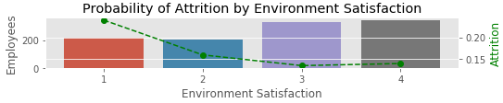
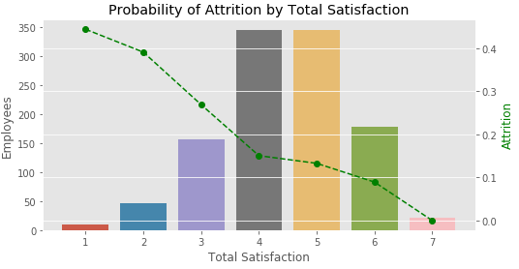
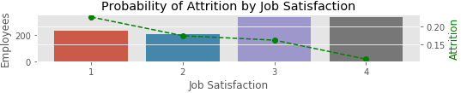
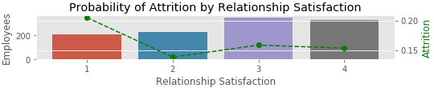
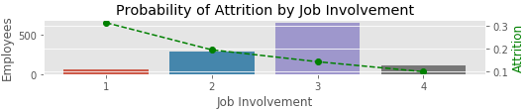
Feature Engineering: Illustration
1
B
Combining satisfaction surveys produces a powerful predictor of attrition
Total satisfaction is the sum of the following indicators:
If environment satisfaction >= 2 then 1 else 0
If job satisfaction = 1 then -1, if job satisfaction = 4 then 1 else 0
If relationship satisfaction >= 2 then 1 else 0
Add job involvement as is

Slide 11
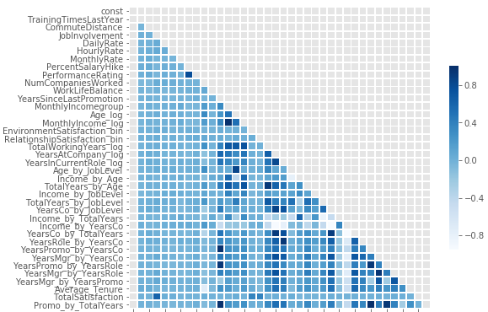
Feature Selection: Correlation Heatmap
1
B
Variables are now highly correlated and will need to be trimmed to ensure interpretability
Correlations should ideally be under 0.7 to ensure adequate interpretation of regression coefficients

Slide 12
Variance Inflation Factor
1
B
Many variables are over the maximum range of a 5-10 VIF

Slide 13
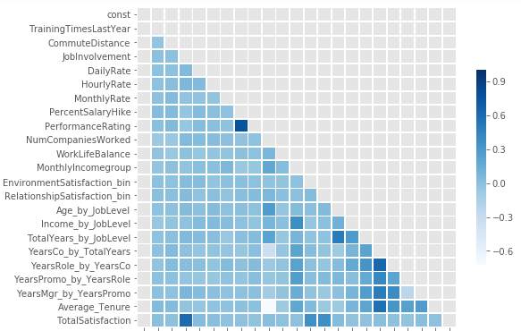
Feature Selection: Correlation Heatmap
1
B
VIF feature selection has significantly reduced correlation amongst variables

Slide 14
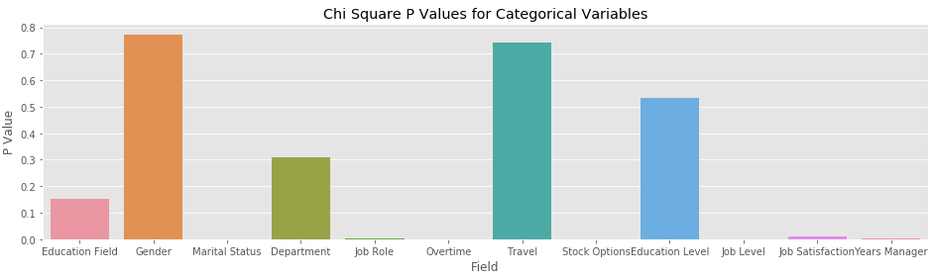
Feature Selection: Chi Square Values
1
B
Categorical variables were also tested to identify those with a significant relationship

Slide 15
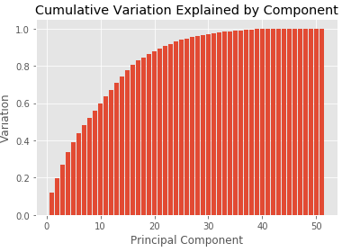
Unsupervised Learning: PCA
1
C
The first two components only account for 20% of the variation in the data set
Low variation explained is unsurprising given the orthogonality created during feature selection

Slide 16
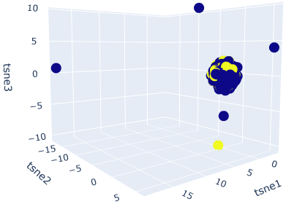

Unsupervised Learning: TSNE
1
C
Clusters are not easily visible, nor observations easily separable, but data are spherical

Slide 17
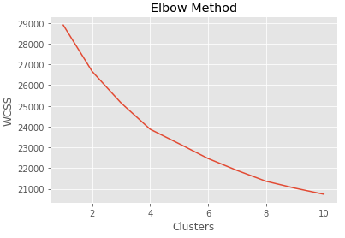
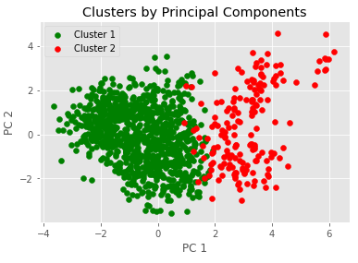
Unsupervised Learning: K-Means
1
C
Two clusters were identified, with a link to performance, which could aid modeling
Two clusters were chosen based on the elbow method, the amount of data, and to maintain simplicity in interpreting results

Slide 18
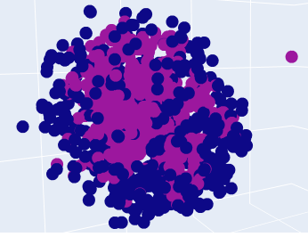
Unsupervised Learning: DB-SCAN
1
C
DB Scan identified two clusters, with differing attrition rates and balanced group sizes

Slide 19
Attrition Modeling: Modeling Approach
2
A
Several important criteria guided the modeling process
Selection
Primary objective is inference, so model interpretability is most important
As a result, Logistic Regression (LR) and Random Forest (RF) were chosen
Segmentation
Given clustering results, sub-models were fit to K-Means and DB-SCAN clusters
However, holdout testing did not perform better, so full model was used
Robustness
Data were randomly split into 75%/25% train/test groups with stratified sampling
Forward selection (LR) and cross-validated grid search (RF) were leveraged
Evaluation
Model residuals were analyzed for patterns
Classification metrics analyzed as well against baseline class distribution

Slide 20
Attrition Modeling: Modeling Results
2
B
Leveraging the original training data produced the most accurate and interpretable results
Retention% = (1 – Attrition %)
LR and RF represent Logistic Regression and Random Forest

Slide 21
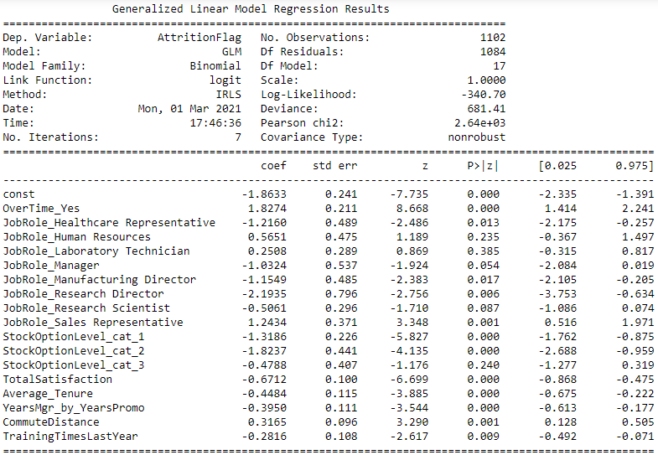
Model Summary: Logistic Regression
2
B
Model accuracy is considerably above 84% baseline
Predicted
Yes
No
Yes
27 | 32
5 | 304
Actual
No
Precision:
84%
Recall:
46%
Accuracy:
90%

Slide 22
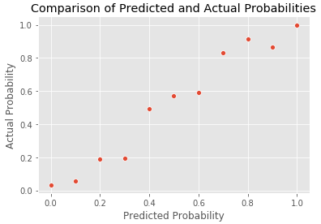
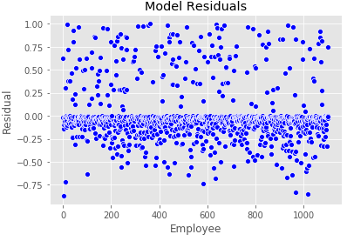
Model Summary: Residual Analysis
2
B
Analysis of the residuals did not identify any major issues

Slide 23
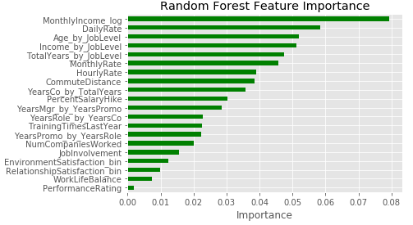
Model Summary: Random Forest
2
B
Model accuracy is above 84% baseline, but with different features than regression model
Predicted
Yes
No
Yes
16 | 43
3 | 306
Actual
No
Precision:
84%
Recall:
27%
Accuracy:
88%

Slide 24
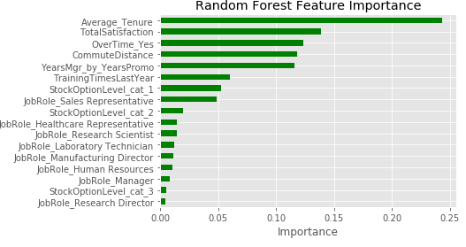
Model Summary: Random Forest
2
B
A model with comparable RF performance was trained using logistic regression features
Predicted
Yes
No
Yes
18 | 41
7 | 302
Actual
No
Precision:
72%
Recall:
31%
Accuracy:
87%

Slide 25
Attrition Modeling: Feature Importance
2
C
Overtime, survey results, and stock options top the list of features
Entry order represents order in which variable was included in forward selection model
Coefficient and normalized coefficient are absolute values from the model
Lost points refers to the credit scoring practice of calculating the maximum possible score for the model and measuring how often each feature represented the most lost points
RF represents the feature importance from the random forest model trained using the logistic regression features
Coefficient Rank is a monte carlo simulation to get a distribution of parameter estimates. For each variable the 5th, 50th, and 95th percentile coefficient is ranked against the model coefficients

Slide 26
Feature Importance: Top Model Scores
2
C
Those most likely to leave often have low survey results, low tenure, and new managers
Trainings | Commute | Job Role | Overtime | Stock Option Level | Years Manager / Years Promotion | Average Tenure | Total Satisfaction | Model Probability | Attrition Indicator
2 | 22 | Sales Rep | Yes | 0 | 0.00 | 0.00 | 5 | 95% | 1
3 | 21 | Sales Rep | Yes | 0 | 0.00 | 0.30 | 4 | 95% | 1
4 | 24 | Sales Rep | Yes | 0 | 0.00 | 0.30 | 4 | 94% | 1
3 | 13 | Human Resources | Yes | 3 | 0.00 | 0.28 | 2 | 93% | 1
2 | 19 | Sales Rep | Yes | 3 | 0.00 | 0.30 | 4 | 93% | 1
0 | 25 | Research Scientist | Yes | 0 | 0.51 | 0.31 | 3 | 90% | 1
2 | 24 | Sales Exec | Yes | 0 | 0.51 | 0.33 | 3 | 90% | 1
2 | 11 | Research Scientist | Yes | 0 | 0.00 | 0.30 | 2 | 89% | 1
3 | 5 | Sales Rep | Yes | 0 | 0.00 | 0.00 | 5 | 89% | 1
2 | 9 | Sales Rep | No | 0 | 0.51 | 0.40 | 1 | 89% | 1
2 | 2 | Lab Tech | Yes | 0 | 0.00 | 0.60 | 2 | 89% | 1
3 | 24 | Lab Tech | Yes | 0 | 0.00 | 0.30 | 4 | 88% | 1
2 | 1 | Lab Tech | Yes | 0 | 0.00 | 0.28 | 3 | 87% | 1
2 | 3 | Sales Rep | Yes | 0 | 1.10 | 0.53 | 3 | 87% | 1
3 | 1 | Sales Rep | Yes | 0 | 0.69 | 0.53 | 3 | 87% | 1
2 | 5 | Sales Rep | Yes | 0 | 0.00 | 0.30 | 5 | 87% | 1
2 | 10 | Sales Rep | No | 0 | 0.00 | 0.00 | 3 | 87% | 0
2 | 22 | Human Resources | No | 0 | 0.00 | 0.30 | 2 | 86% | 1
2 | 16 | Sales Rep | Yes | 0 | 0.00 | 0.60 | 3 | 86% | 1
3 | 1 | Sales Rep | No | 0 | 0.00 | 0.48 | 1 | 85% | 0
Values that lead to increased attrition
Values that lead to decreased attrition

Slide 27
Feature Importance: Low Model Scores
2
C
Those least likely to leave are often non-overtime, with short commutes, and high tenure
Trainings | Commute | Job Role | Overtime | Stock Option Level | Years Manager / Years Promotion | Average Tenure | Total Satisfaction | Model Probability | Attrition Indicator
6 | 2 | Manufacturing Director | No | 2 | 2.08 | 0.71 | 6 | 0.05% | 0
4 | 1 | Research Director | No | 2 | 0.00 | 0.77 | 7 | 0.05% | 0
2 | 1 | Manager | No | 1 | 1.50 | 1.45 | 7 | 0.05% | 0
5 | 2 | Research Director | No | 1 | 1.18 | 1.42 | 4 | 0.07% | 0
3 | 1 | Research Director | No | 2 | 1.10 | 1.31 | 4 | 0.07% | 0
4 | 2 | Manufacturing Director | No | 1 | 1.70 | 1.52 | 5 | 0.08% | 1
2 | 1 | Sales Exec | No | 1 | 2.30 | 1.34 | 7 | 0.11% | 0
6 | 2 | Manufacturing Director | No | 1 | 1.50 | 0.65 | 6 | 0.12% | 0
4 | 7 | Research Director | Yes | 1 | 1.79 | 1.43 | 6 | 0.13% | 0
4 | 8 | Sales Exec | No | 2 | 2.20 | 0.79 | 7 | 0.13% | 0
6 | 9 | Manufacturing Director | No | 1 | 2.20 | 0.84 | 5 | 0.14% | 0
4 | 1 | Healthcare Rep | No | 0 | 1.61 | 1.22 | 7 | 0.14% | 0
5 | 1 | Healthcare Rep | No | 3 | 1.01 | 1.39 | 6 | 0.14% | 0
2 | 1 | Research Director | No | 2 | 1.50 | 0.45 | 5 | 0.14% | 0
5 | 10 | Manager | No | 1 | 2.30 | 1.41 | 4 | 0.15% | 0
4 | 2 | Healthcare Rep | No | 2 | 0.51 | 0.79 | 6 | 0.16% | 0
4 | 2 | Research Scientist | No | 2 | 1.39 | 1.22 | 5 | 0.18% | 0
5 | 5 | Manufacturing Director | No | 0 | 2.64 | 1.36 | 5 | 0.19% | 0
3 | 1 | Manager | No | 1 | 1.95 | 0.63 | 6 | 0.20% | 0
Values that lead to increased attrition
Values that lead to decreased attrition

Slide 28
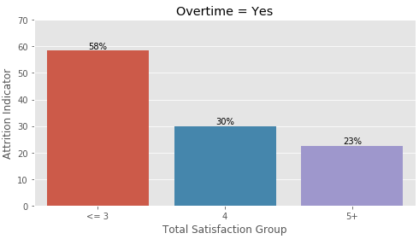
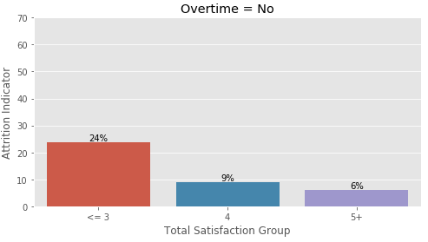
Insights: Overtime and Total Satisfaction
3
A
Overtime is a strong predictor of attrition; total satisfaction adds further segmentation
Grouped as lower risk for remaining slides
Employees
65
130
221
206
328
520

Slide 29
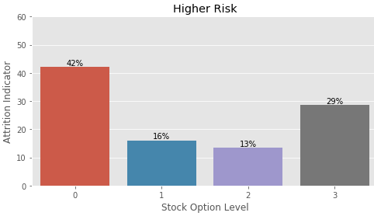
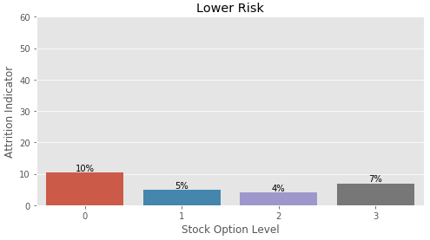
Insights: Stock Option Level
3
A
Within risk groups, stock option levels are predictive of attrition
Employees
277
243
60
42
354
353
98
43
Higher Risk: Overtime = Yes or Total Satisfaction <= 3
Lower Risk: Overtime = No and Total Satisfaction >= 4

Slide 30
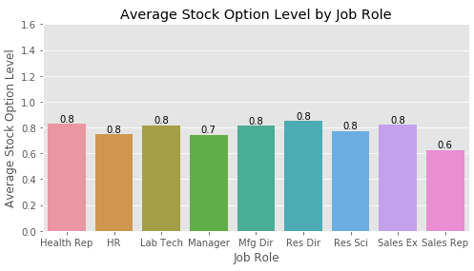
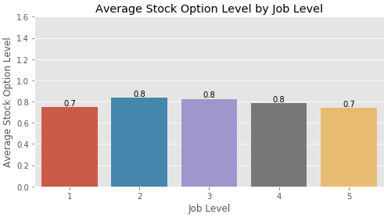
Insights: Stock Option Level
3
A
Stock options are surprisingly uncorrelated with Job Role or Job Level
Employees
131
52
259
102
145
80
292
326
83
543
534
218
106
69

Slide 31
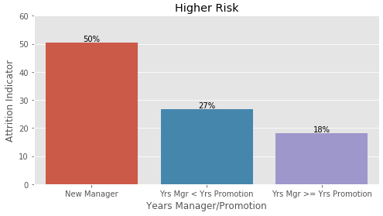
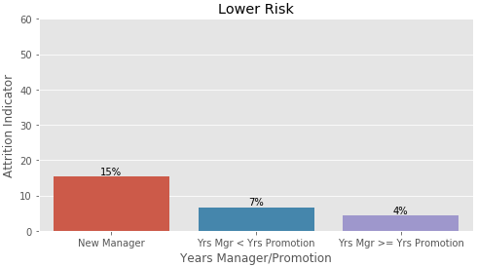
Insights: Years Manager/Years Promotion
3
A
Having a new manager since their last promotion is predictive of employee attrition
Employees
127
258
237
136
389
323
Higher Risk: Overtime = Yes or Total Satisfaction <= 3
Lower Risk: Overtime = No and Total Satisfaction >= 4

Slide 32
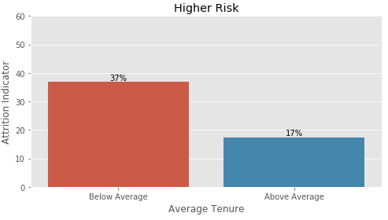
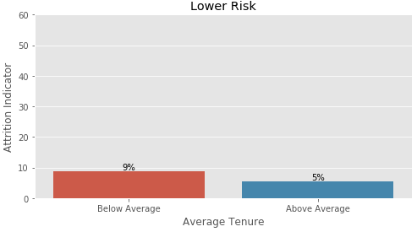
Insights: Average Tenure
3
A
Employees with lower average tenure are more likely to leave, even within risk groups
Employees
347
275
455
393
Higher Risk: Overtime = Yes or Total Satisfaction <= 3
Lower Risk: Overtime = No and Total Satisfaction >= 4

Slide 33
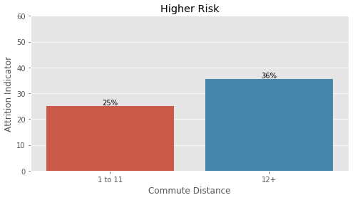
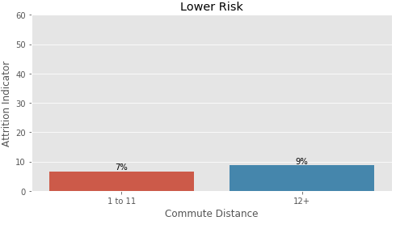
Insights: Commute Distance
3
A
Employees with longer commutes are more likely to leave, even within risk groups
Employees
425
197
630
218
Higher Risk: Overtime = Yes or Total Satisfaction <= 3
Lower Risk: Overtime = No and Total Satisfaction >= 4

Slide 34
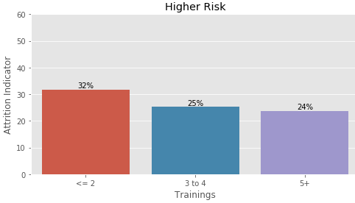
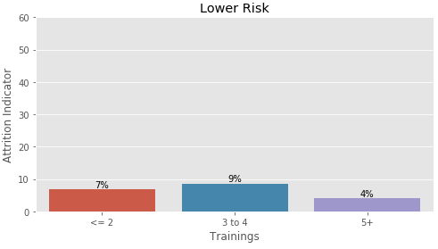
Insights: Trainings
3
A
The number of trainings is moderately predictive of employee attrition within risk groups
Employees
305
254
63
367
360
121
Higher Risk: Overtime = Yes or Total Satisfaction <= 3
Lower Risk: Overtime = No and Total Satisfaction >= 4

Slide 35
Insights: Hypotheses of Causal Factors
3
B
The action items from the analysis are hypotheses to test with business and data experts

Slide 36
Insights: Recommend Next Steps
3
C
Connect with internal data experts to answer questions on key metrics (e.g. Overtime)
Consult with business experts to understand what may be leading to some of these insights, as well as collaborate on potential solutions
Develop an action plan to address areas of problematic, voluntary attrition
Socialize recommendations, gain buy-in from business leaders, execute action plan and measure progress of retention initiative

